Slide 1

AW Workflow with Synergist
Prepared by Claire Rollinson, November 2012

Slide 2
Contents
Creating your custom ‘views’ 5- 11
Promoting a prospect to client
Adding client contacts
Creating a client template for a master template
Creating a new job/opportunity from a client template
Creating job timelines (GANTT Charts)
Billing plans
Scheduling work into production – use whiteboards
Briefing in and working on amends
Creating a recurring job ( such as for monthly reporting or strategy /CM retainers)
Completing and posting, approving timesheets
Creating and approving invoices
Creating and viewing activities
Attachments and adding documents (to be added)
Reports
Appendix one – Clients on monthly retainers
Appendix two – Details of setting up a job/opp up from scratch

Slide 3
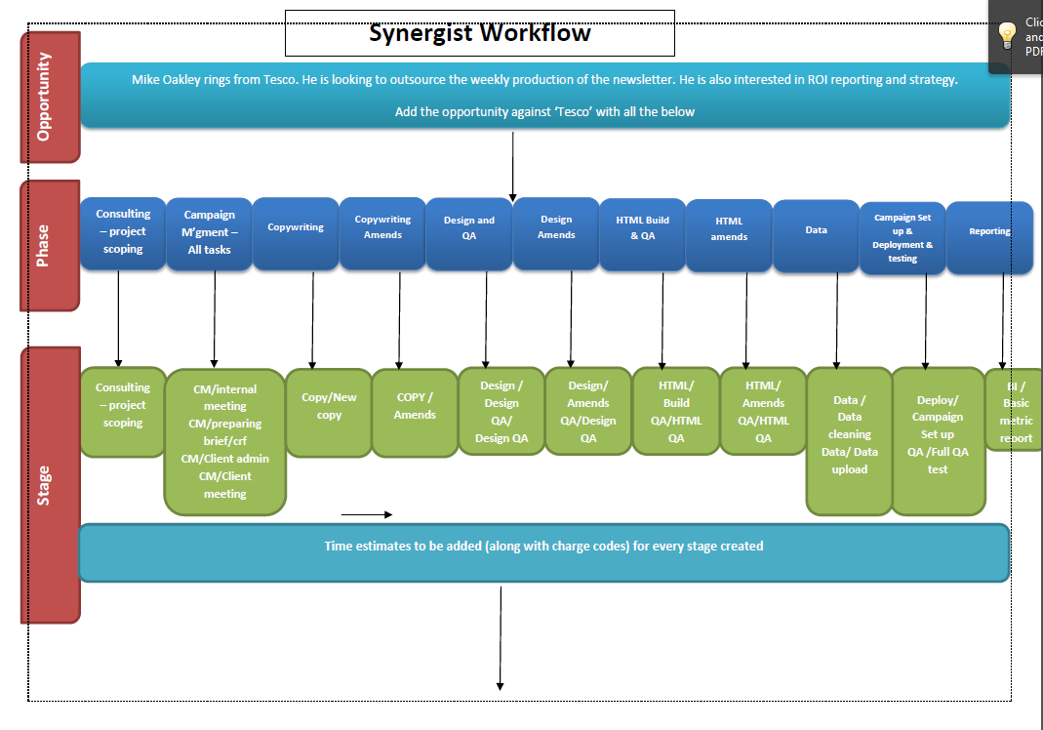
Overview - REDO

Slide 4
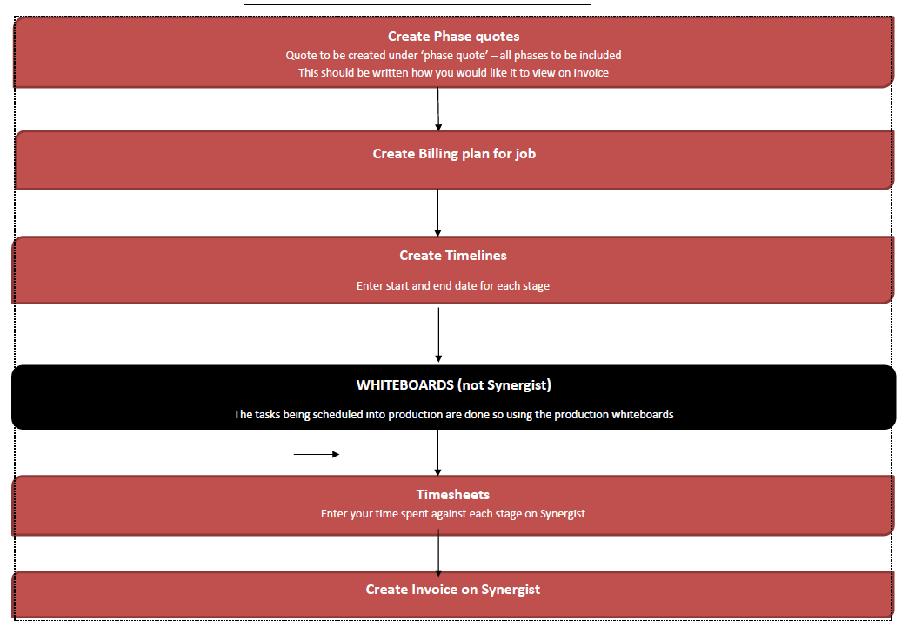

Slide 5
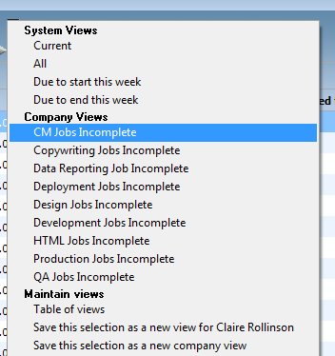
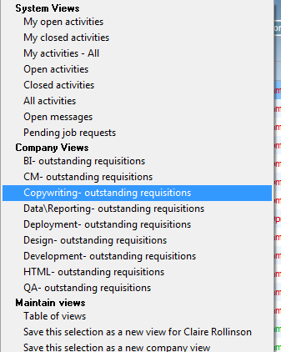
Views
To aid with your searching of jobs, activities you should set up your own ‘views’ at the start of using Synergist.
There already will be a set of company views created which will help you, and which have been set up to benefit the whole company/team ( see below)

Slide 6
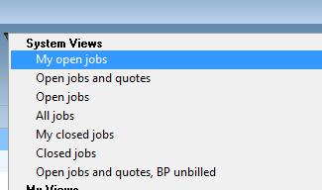
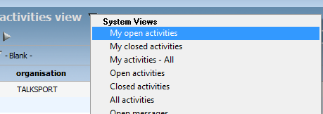
CM views to use
1 ‘my_open jobs’
Is already set up as a system view
2 ‘my_open activities’
Is already set up as a system view

Slide 7
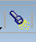
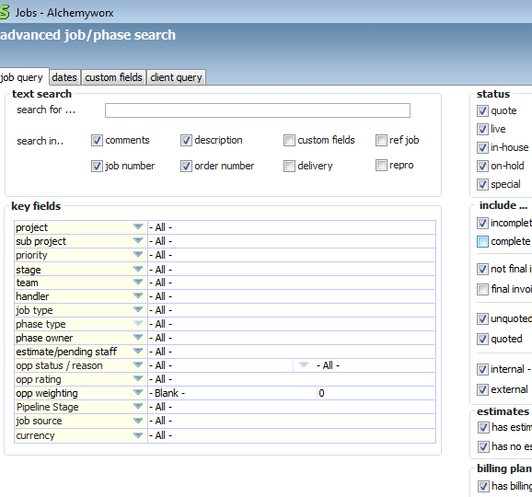
CM views to set up
1. ‘Client live jobs’ view
Eg Aviva live jobs.
- to create this view, navigate to the ‘job’ screen on the left-handside of the menu and then click on the search, icon

Slide 8
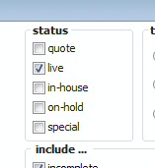
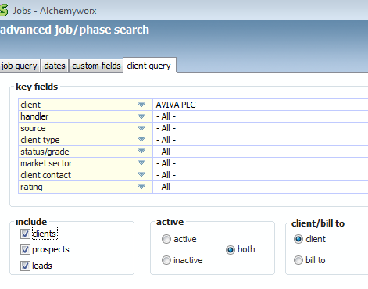
CM views to set up
Status – tick just live jobs
Navigate to ‘client query’ tab and select
the client you want to create it
for

Slide 9
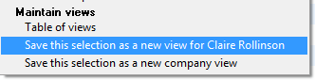
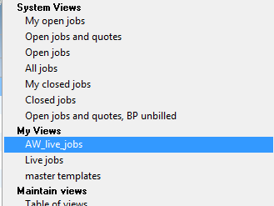
CM views to set up
3. Save the view as a new view for
yourself as ‘client_live_jobs’
4. You will now have this view saved under
‘my views’

Slide 10
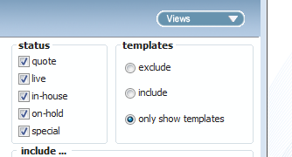
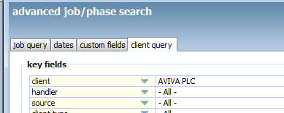
CM views to set up
2 ‘client_templates’
Select ‘all jobs’ under status and select ‘only
show templates’ under templates
Select ‘client’ you wish to view templates for
Underneath the ‘client query’

Slide 11
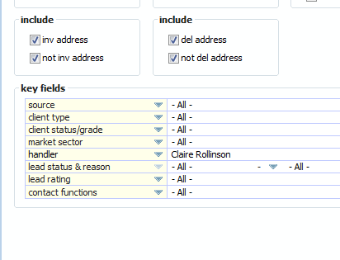
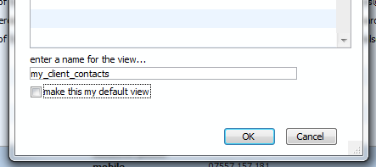
CM views to set up
3 ‘client_contacts’
(To show all the contact you work with/are assigned to’
Navigate to contacts tab, click on the search tab and select yourself as ‘handler’
Save the view as a view for yourself
As ‘my_client_contacts’

Slide 12
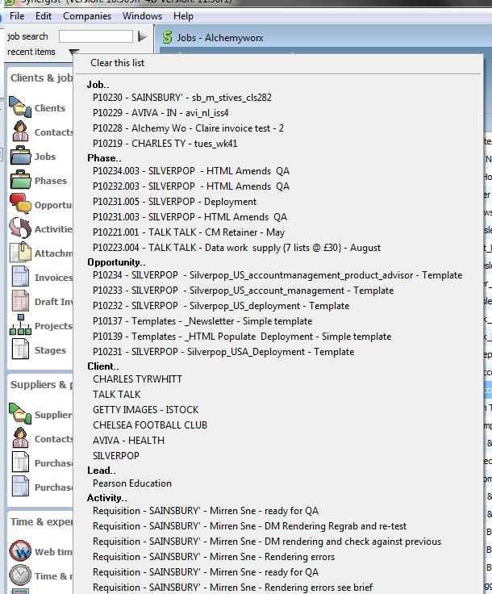
Quick tips - navigation
Clicking on ‘recent items’ at the top left hand of the screen will take you to your most recent items you have been in

Slide 13
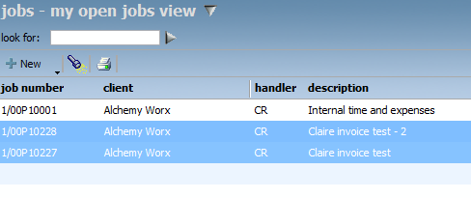
Quick tips – batch update
You can update a group of jobs (such as completing the job) all at the same time by completing a batch update rather than going into each job separately.
Ctrl and select the jobs you want to complete a batch update on
Go to actions in the top right hand of screen

Slide 14
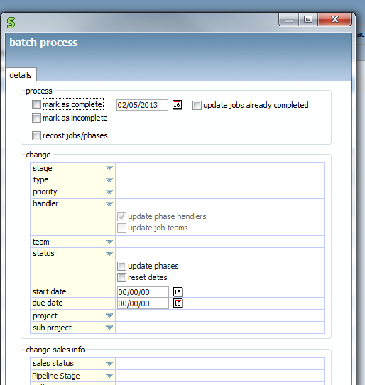
Quick tips – batch update
Click ‘mark as complete’
Then tick ‘process’

Slide 15
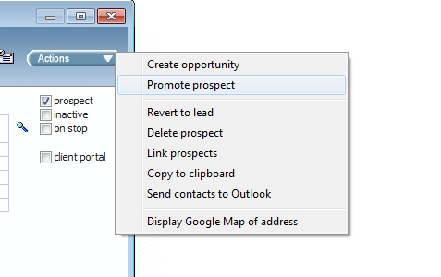
Prospects > Clients
When a prospect becomes a Client, New Business team will convert a Prospect to a Client on Synergist

Slide 16
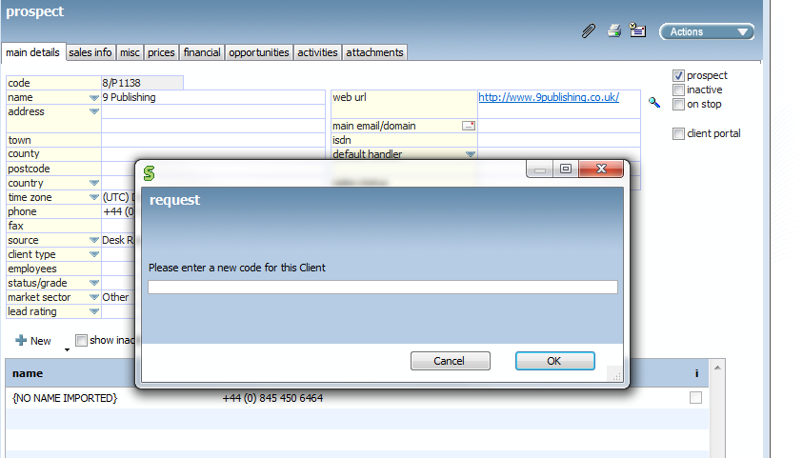
Prospects > Clients - 2
You will be asked to enter a new code for the client which is 8 characters long. Enter the first 8 chars of the client’s name?

Slide 17
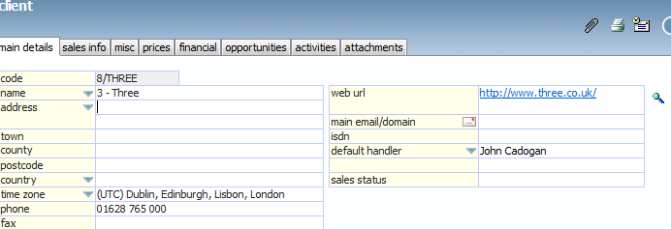
Prospects > Clients - 3
Add the CM assigned to the new client as the ‘default handler’
Signed off SOW/proposal should be saved by Nick in the ‘proposals’ and ‘contracts’ folders.
Ensure ‘client type’ of “US” ”UK” “UK retained,” “US retained” is filled in

Slide 18
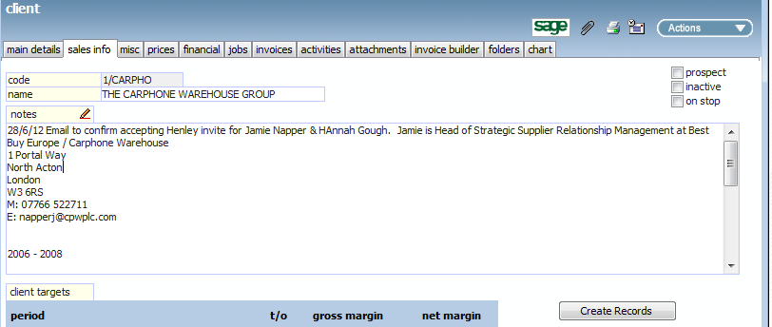
Prospects > Clients - 4
CM to ensure that all client contacts have been added
CM to read any sales info notes and have a handover meeting with new business

Slide 19
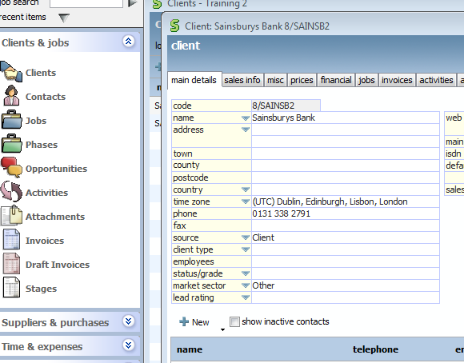
Adding contacts to ‘clients’
Navigate to the client record you want to add the contact for
Click on ‘new’

Slide 20
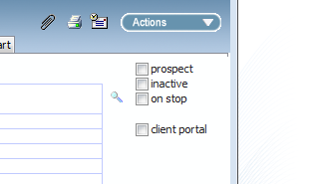
Adding contacts to ‘clients’ - 2
Add title, first name and last name
Add email address and job title
Ensure ‘salutation’ has their first name listed
Tick if they are your day to day contact ‘operational Daily’, ‘billing’ contact or ‘Strategic decision maker’
Add direct phone, mobile number, fax and linked in page if you have it
If they are the person we should send the invoice too, tick the box ‘invoice address’ or ‘cc invoice recipient’
If a contact leaves an organisation please note them as ‘inactive’

Slide 21
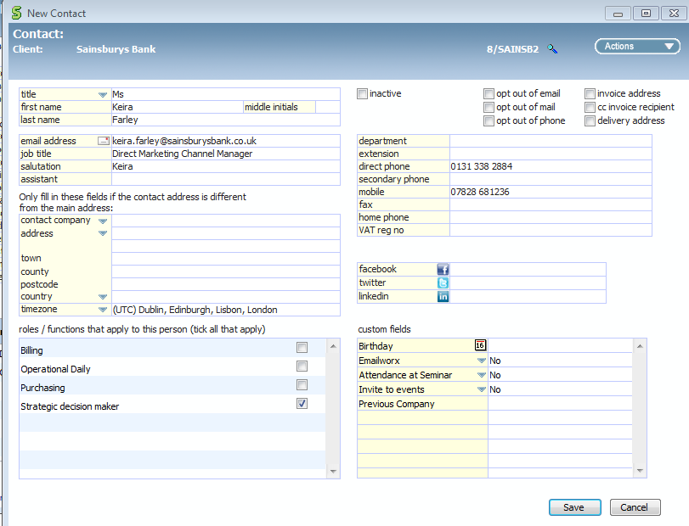
Adding contacts to ‘clients’ - 3

Slide 22
Synergist Terminology Guide
Can be found here
Z:\operations\projects\synergist\_Synergist_Collateral\Synergist_Terminology_Guide.docx

Slide 23
Overview of adding and managing a job
Create a new job from a template or existing job
Use job number from Synergist and job description to create job folder on server
Check you have all the right phases and stages for job – delete or add phases as required
Check all time estimates and estimated charges are correct in the ‘full estimate’ – amend as required
Check ‘phase quote’ Are all billable items listed? If not rebuild quote and ensure CM fee is correct
Check ‘billing plan’ – it should be ‘syncronize planned value with quote’
Add ‘timelines’ – add start and end dates for all stages
Job now ready to schedule into production using whiteboards
Once job is completed, complete the draft invoice
Once invoice is completed ‘complete job’ – tick ‘completed’ in the financial screen
Timesheets should be completed at the end of the day and posted by Monday of the following week

Slide 24
Opportunities
What are they?
This is a quote status Job with a unique Job number. It is the ability to record an Opportunity for some work. This may be with an existing Client or an Opportunity for new business with a Prospect. Opportunities can be Lost/Deadened or promoted to Live
See pages 8 -11 of the user guide for details on how to create an opportunity with Z:\operations\projects\synergist\_Synergist_working_folder\Guidance_Docs_

Slide 25
Opportunities – prospects
New Business and Consulting to own the adding of new prospects and new opportunities to Synergist
New Business and Consulting ‘own’ promoting them to clients
For opportunities against in-life clients CM can promote opps to live jobs once quote has been signed off.

Slide 26
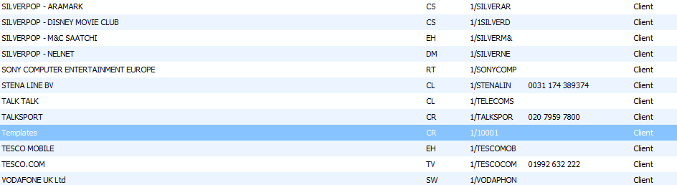
Templates
Majority of rate card jobs have been set up as master templates and have been assigned to the fictional client of ‘templates’

Slide 27
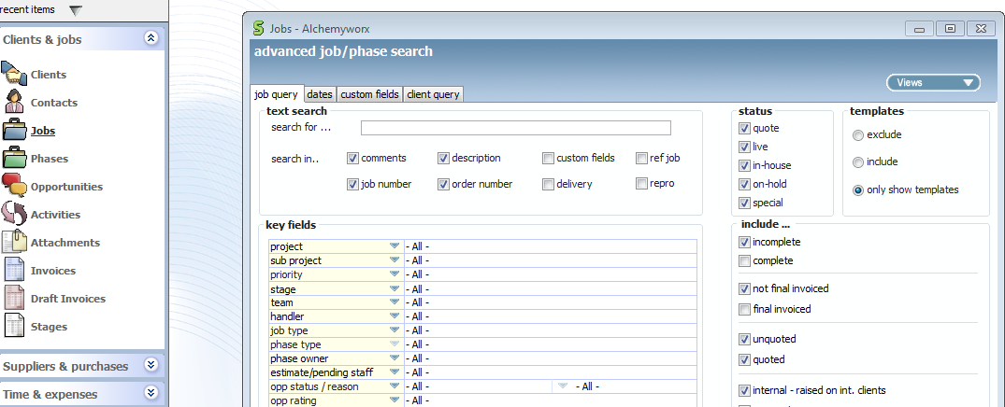
Templates
You can view all ‘master templates’ created by clicking on ‘job’s and then ‘search.’
Tick ‘only show templates’

Slide 28
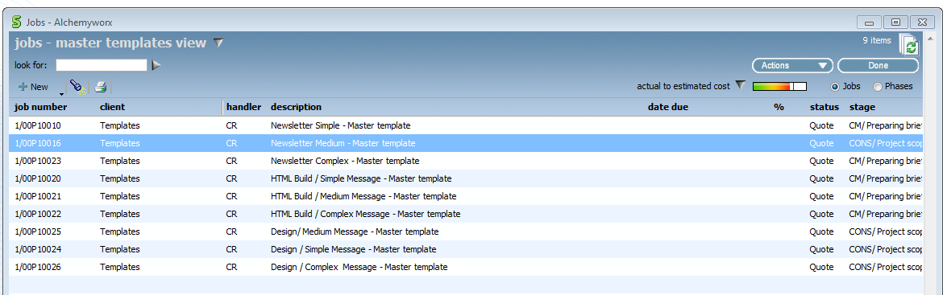
Templates
To create your client templates for regular/BAU jobs please select a master template to create it from the list below

Slide 29
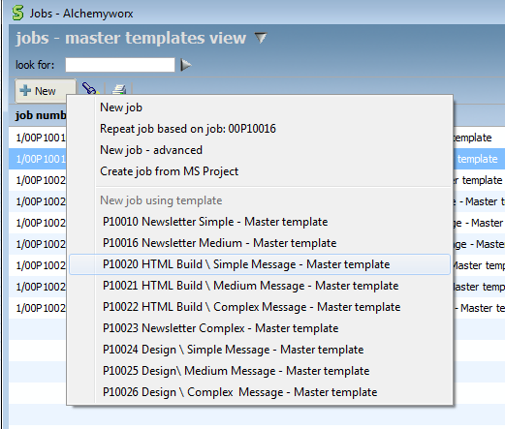
Creating a new ‘client template’ opportunity
Navigate to ‘jobs’, click on new and select the template you wish to base your template on

Slide 30
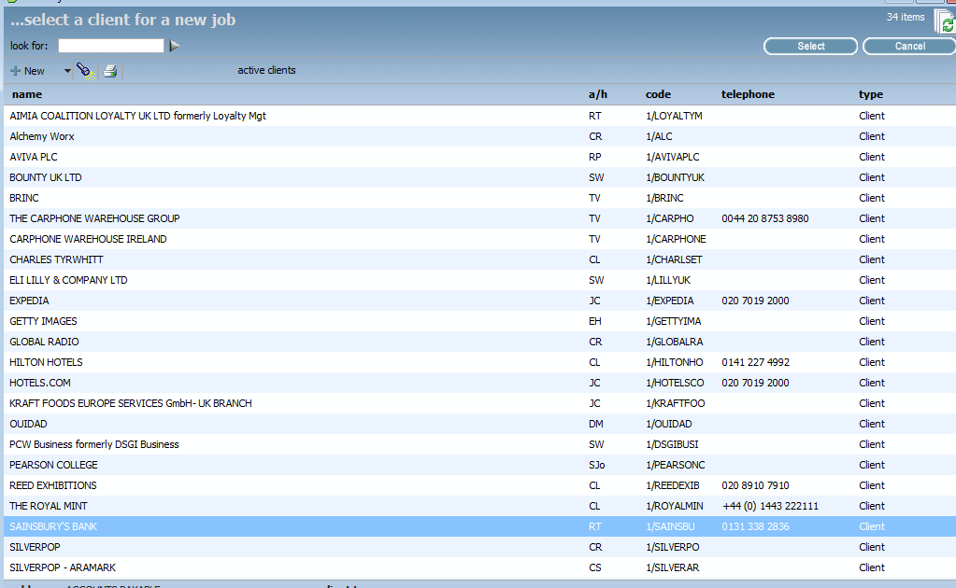
Creating a new ‘ client template’ opportunity - 2
Select the client you wish to make a template for

Slide 31
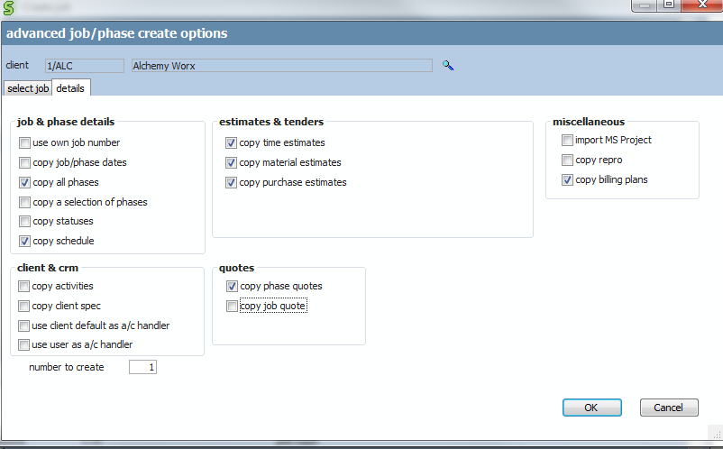
Creating a new ‘client template’ opportunity - 3
Click on ‘details’ tab. All phases, quote details and time estimates should be copied over. Click ‘ok’
Also tick ‘copy billing plans’

Slide 32
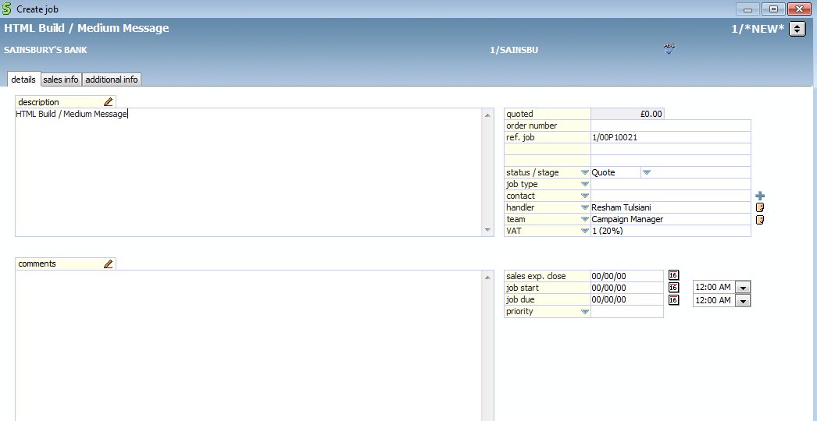
Creating a new ‘client template’ opportunity - 4
Amend job description by removing the term ‘master template’ and name your client template – eg “Aviva_Newsletter – Medium”
Status/stage should be set to ‘quote’
Ensure account handler (i.e CM/CE) is updated and correct
Ensure job start date and job due date are set to 00/00/00
Set priority to ‘medium’
Tick the ‘template’ box (bottom left of screen)

Slide 33
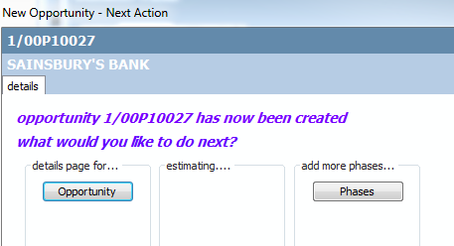
Creating a new ‘client template’ opportunity - 5
Click ‘ok’ and now navigate to details page for ‘opportunity’

Slide 34
Creating a new ‘client template’ opportunity - 6
You have now copied over all the phases, stages, internal charges, and time estimates for that particular rate card job.
You need to ensure all phases for template are required ( delete any that are not)
You will also need to delete all phase start and end dates, amending them to 00/00/00
You need to check all estimates have the correct charge codes assigned to them and update any client specific pricing in the ‘phase quote’ section

Slide 35
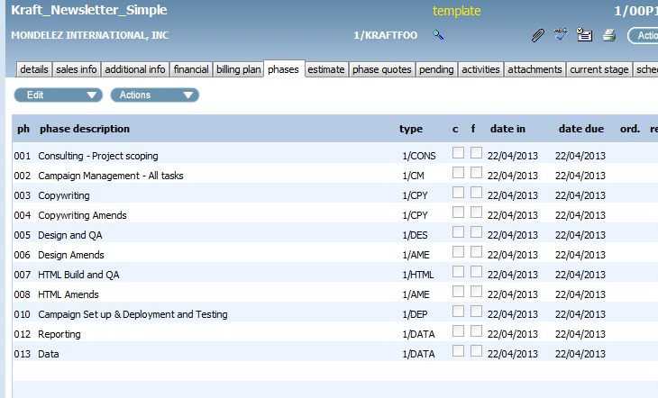
Creating a new ‘client template’ opportunity - 7
Navigate to the ‘phases’ tab
Delete any phases that are not required for your job
(Please note people can only add timesheets to phases and stages that are listed for that job. So if in doubt keep the phase)

Slide 36
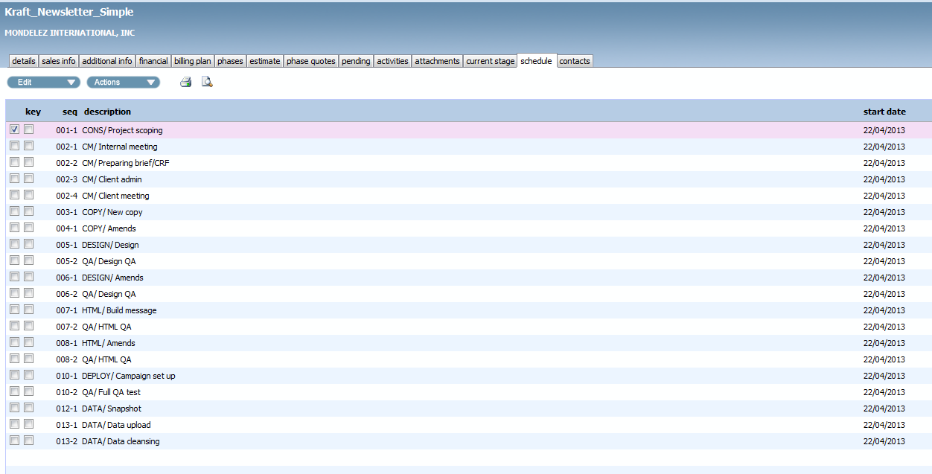
Creating a new ‘client template’ opportunity – 7b
Navigate to the ‘schedule’ tab
Delete or add any key stages that are not required for your job

Slide 37
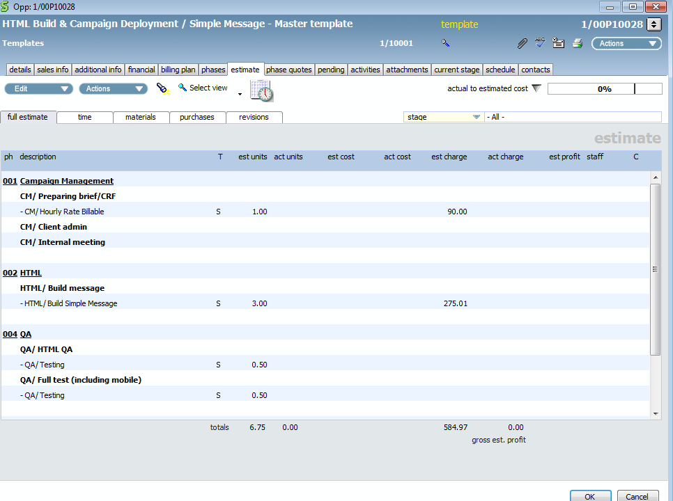
Creating a new ‘client template’ opportunity - 8
Navigate to the ‘estimate tab’ of your client template

Slide 38
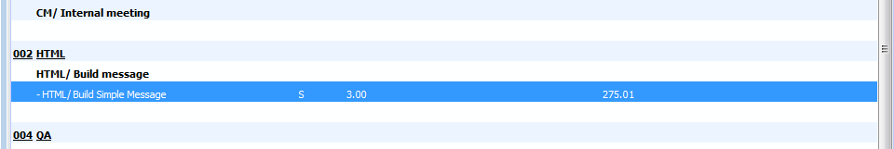
Creating a new ‘client template’ opportunity - 9
Check each charge code description matches to the template you are creating. For example you may need to amend the HTML build charge code and stage to HTML Populate charge/code
Double click on the entry below to get to the estimate screen and amend the charge code and stage here
For client specific pricing. Keep the no of hrs as on master template, just amend the hourly rate to get the total to add up to the amount you need

Slide 39
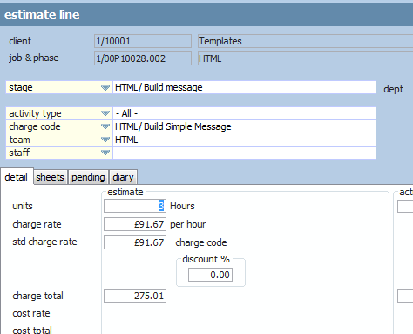
Creating a new ‘client template’ opportunity - 10
If you need to amend the charge code and add in new time estimates you can find these details on pages 135 of this document

Slide 40
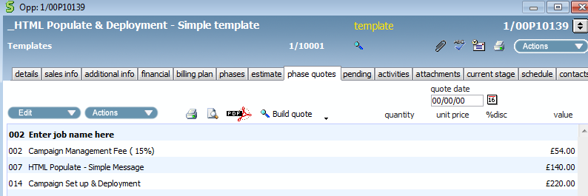
Creating a new ‘client template’ opportunity - 11
Now you need to check and amend the quote for the template
Navigate to the ‘phase quote’ section and update the client charges. Please note the CM fee needs to be manually updated so please work out the CM fee from the costs and add this
Keep the line entry ‘enter job name here’ on template
Keep all the ‘spare line entries’ this may make it easier for you to build quote on your jobs
Delete all entries for the ‘quantity’ (which refers to estimates hrs except for Silverpop clients) ‘unit price’ and ‘% disc’ on the quote

Slide 41
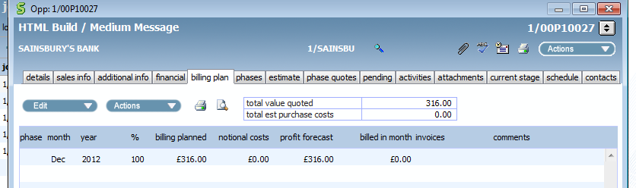
Creating a new ‘client template’ opportunity - 12
Navigate to the ‘billing plan’ tab and check the total is the same as the phase quote total ( if its isn’t, edit the billing plan entry and ensure the ‘synchronize planned value with quote’ is selected)

Slide 42
Creating a new ‘client template’ opportunity - 13
Your client template is now created!

Slide 43
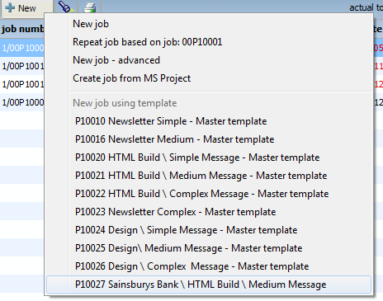
2. Creating a job from a client template
Go to ‘job’s on the right menu bar.
Select new and then select from the template list below or ‘repeat job’ based on client job done previously

Slide 44
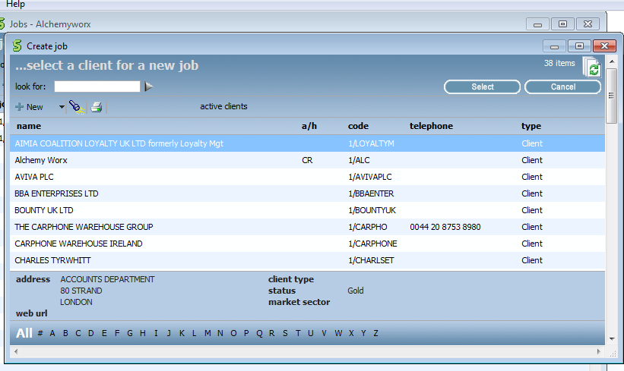
Selecting client
Select client you wish to create a job for by double clicking on client name

Slide 45
Template details to copy over
Click on ‘details’ tab. All phases, quote details and time estimates should be copied over. Click ‘ok’
Ensure ‘copy billing plans’ is ticked

Slide 46
Things to update on job record
Amend job description from ‘template’ to a description of the project completing.
Delete job no in ‘ref.job’ field. This relates to template and not job you are working on
Order no: if you have a PO number enter it here. ( Once you get a PO add it in this field)
Update status/stage from quote to ‘live job’ and enter the first stage you are going to work on (if job is straight into production)
Add client contact name in the ‘contact’ field
Ensure account handler (i.e CM/CE) is updated and correct
Enter ‘job start date’ and ‘job due’ date
Priority ( High/medium or low) Medium is default.

Slide 47
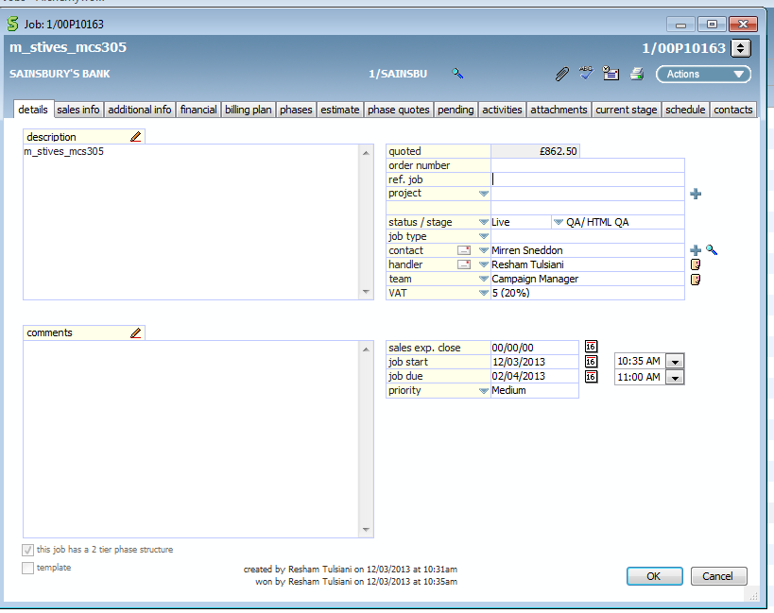
Things to update on job record (2)
.

Slide 48
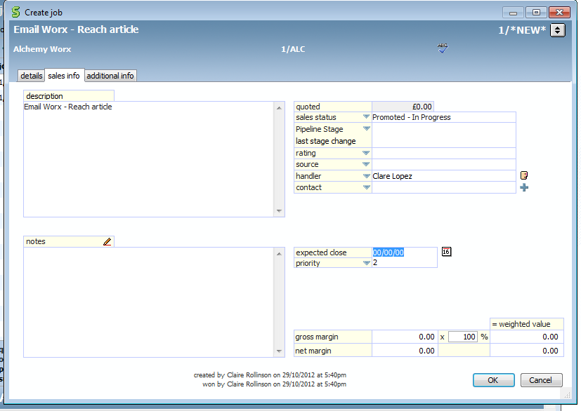
Things to update on template
Sales info.
Ensure client contact details are added
Then click ‘ok

Slide 49
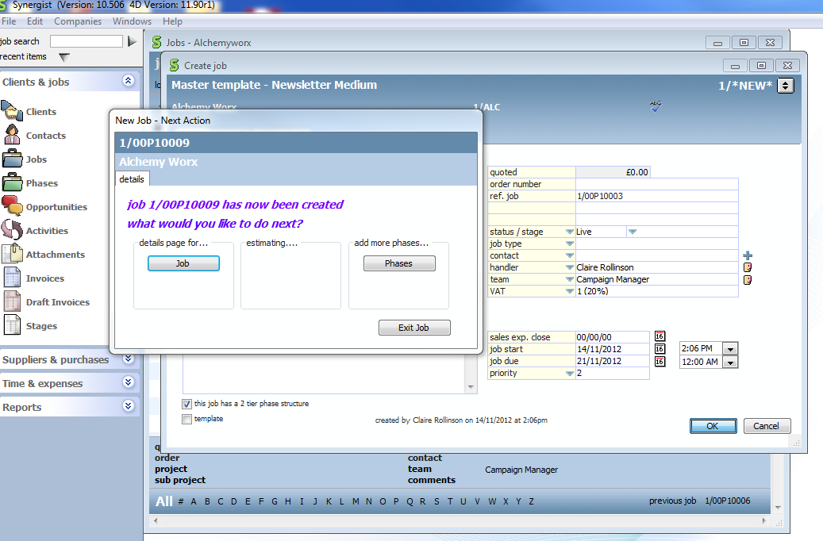
Add details for job

Slide 50
Job record
You have now created your job
You now need to ensure you only have the relevant
phases required for your job on Synergist
Create job folder on server using the job no from Synergist and the job description you have used
sb_p10212_m_stives_gcs131

Slide 51
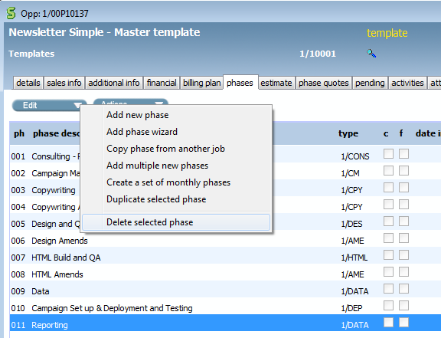
Job record - 2
Navigate to the ‘phases’ tab
Delete any phases that are not required for this specific job

Slide 52
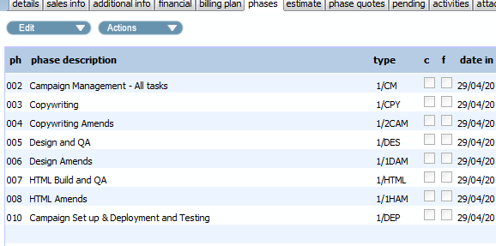
Job record - 3
Now you have just the phases you need for your job
Please ensure you select the correct phase type for the phase. Eg Design amends should be set up in the ‘design amends’ phase type

Slide 53
Job record - 4
If you need to add or amend phases complete this now
See slides 135 onwards for adding phases and stages
One thing to ensure is that you have a time estimate against every stage
And that you add each phase against the right phase type – as phase types are linked to the nominal codes

Slide 54
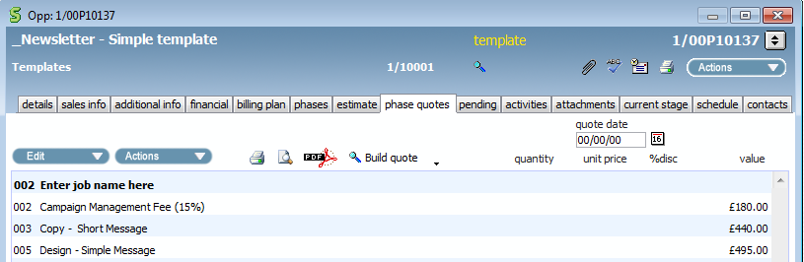
Job record - 5
Phase Quote
Check and update the phase quote for your job
Enter the job name at the top of the quote
The CM fee will also need to be updated on the phase quote
Keep all the ‘amends’ line entries if you are not sending out quote
Recalculate CM fee manually based on job quote total and your client CM charge and enter the revised figure in the CM ‘line entry’
Delete all entries for the ‘quantity’ (which refers to estimates hrs EXCEPT for silverpop clients) ‘unit price’ and ‘% disc’ on the quote

Slide 55
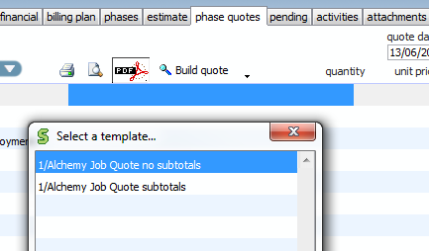
Job record - 6
Phase Quote (cont)
Once you have completed the quote, you can print off and save it as a PDF to send to the client.
Click on ‘pdf’
Select quote date to ‘todays date’
Select ‘1/Alchemy Job Quote no subtotals’
Click ok and select where to save the quote

Slide 56

Job record - 7
You also need to add project/stage timelines

Slide 57

Creating and adding job timelines
Click on ‘action’s button in the top right hand side and select ‘Gantt’

Slide 58

Creating and adding job timelines - 2
At the top under ‘build’ select ‘ job/stage’ view
We need to enter start and end dates for each phase and each stage
As it’s a high level view the dates for most stages will be the same as their phase. For eg design phase and ‘design’ stage
Job start and end date should be populated (from earlier) all other dates will 00/00/00 and will need to completed

Slide 59

Creating and adding job timelines - 3
Enter dates for each stage starting from the first stage.
You will need to enter the end date first as below, and then the start date

Slide 60
Creating and adding job timelines - 4
Design QA stage to be the same start and end date as design stage
HTML QA stage to be the same start and end date as HTML stage
QA/Full test to be the same dates as campaign set up.
Campaign set up end date should be deployment date

Slide 61

Completed timelines/GANNT
Re do this slide

Slide 62

Billing plans
A default billing plan has been set up for all signed off jobs on job due date to create financial projections
Ensure the billing planned billing is set to 100% of the planned value.
With the ‘synchronize planned value with quote’ box ticked (this will ensure the billing plan is updated with any amend costs you add later)
This will set 100% of the job and all phases to be invoiced on the job due date.

Slide 63

Billing plans - 2
This shows you that 100% of the job (£2,325) will be billed on job due date – November 2012

Slide 64

Billing plan -3
Creating manual plans for large projects which may be billed 50% upfront on start and 50% on completion, you will need to amend your manual billing plan, as below.
For these jobs an extra billing entry will need to be created (on ‘job start date’) and the existing billing entry will need to be amended.

Slide 65

Billing plan -4
Select ‘new billing plan entry’

Slide 66

Manual Billing plan -5
Create an entry with a ‘fixed date’ to job start date
Amend ‘planned billing’ entry to ’50%’

Slide 67

Manual Billing plan -6
Amend the billing entry for ‘relative to’ job due’ date
Amend ‘planned billing’ entry to ’50%’

Slide 68

Manual Billing plan -7
You will now have two billing plan entries, showing you are forecasting to bill 50% of the job when you start and 50% of the job on completion

Slide 69
Scheduling work to production
You are now ready to schedule work to the production team!
Please use production whiteboards as you would do normally
As stages are complete please ‘complete’ them on Synergist

Slide 70

Completing stages
As stages are complete please ‘complete’ them on Synergist

Slide 71

CM briefing in Amends
Stages of design/HTML/copy amends are already listed for each job as part of the template underneath the phase of ‘design amends’ ‘HTML amends’ ‘copy amends’ or ‘deployment amends’
Add the date the amends job came in and when they are due.

Slide 72

Briefing in Amends - 2
Click on ‘actions’ and then select ‘add time estimate’

Slide 73

Briefing in Amends - 3
Add charge code of ‘DESIGN/Amends’
Assign it to design team
Add units of time/estimate for job
Add the amends fee, if the amends are incurring a fee. Otherwise keep it as £0

Slide 74

Amends – adding client charges/quote
Click on ‘quote’ tab

Slide 75

Amends – adding charges/quote - 2
Click on ‘edit’ and then ‘add line’
Enter ‘line description’ and ‘unit price’ /charge of amends

Slide 76

Amends – adding charges/quote - 3
The line entry will now be on the ‘phase quotes’
Important! You will need to amend the CM fee if it is a % of job total

Slide 77
Amends – briefing into production
Brief in using the whiteboards in the usual way

Slide 78

Once job is complete
Navigate to the financial tab and tick ‘completed’
This will remove all stages from calendar bookings and remove job from ‘open jobs’
The job is now complete except for the invoice

Slide 79
Creating a recurring job
For some jobs/tasks it makes sense to create one job ( for the year for example) and add a new phase for each tasks.
For example monthly or quarterly reporting jobs, or monthly CM jobs.
See ‘Aviva Consulting – Strategy Retainer’ as an example

Slide 80

Creating a recurring job -2

Slide 81
Creating a recurring job - 3
Add PO number in order number field if you have it
Update status/stage to live
Handler is Janet – as consultant completing project
Start date – date started project
End date – 00/00/00 as its recurring
If the project ever finishes simply complete job as normal

Slide 82
Creating a recurring job - 4
Add PO number in order number field if you have it
Update status/stage to live
Handler is Janet – as consultant completing project
Start date – date started project
End date – 00/00/00 as its recurring
If the project ever finishes simply complete job as normal

Slide 83

Creating a recurring job - 5
Add a phase for each billable entry. In this example we bill for consulting each month
Update the phase start and end date

Slide 84

Creating a recurring job - 6
Add a quote entry for each billable entry. This can be done in phase quote or navigating to the quote tab within each separate phase ( You will then invoice each phase each month)

Slide 85

Creating a recurring job - 7
If you need to add separate stages to the phase. Eg if different teams are working on the task/phase then please add them (example below is for Lilly Quarterly reporting)
It has BI, CM and consulting stages attached

Slide 86
Timesheets
General
All timesheets need to be completed by the end of each day
All hours need to be added
Hours spent on internal work to be added against ‘Internal time and expenses’
Need to add a timesheet entry for each internal meeting and client meeting you have on job
Roll up all activity on briefing into one timesheet entry at the end of the day based on the no of mins/hours spent on that job

Slide 87

Timesheets – CM’s
Navigate to the ‘web time/expenses’ menu option
Click on the ‘web time/expenses’ icon

Slide 88

Timesheets CM’s - 2
Click on ‘timesheets’ tab at the top left handside of the screen

Slide 89

Timesheets CM’s - 3
Select ‘client’, and then ‘job’, ‘phase’, and ‘stage’ you are adding time for. If you are adding time for the previous day you can amend the date here

Slide 90
Timesheets CM’s - 4
Activity type. This should be updated to ‘Campaign Management’
Charge code. For all client work this should be set to ‘CM/Hourly rate Billable’ For all internal tasks ( CM team meeting, internal projects) set this to CM/non billable
Normal hours. Add the amount of time. Use 15 min increments of 0.25, 0.50 0.75 1 hour.
Work done. Add brief description of work completed
Add. Click add one finished

Slide 91

Timesheets CM’s - 5

Slide 92

Timesheets CM’s - 6
Continue to add entries for all jobs you have worked on that day
Once completed and you are happy with all entries for day click on ‘post all’

Slide 93

Timesheets CM’s - 7
Assigning time to non client specific work
Select client of ‘Alchemy Worx’
Select job of ‘Internal time and expenses’
Select phase of ‘internal meetings’ or ‘Research and Admin’

Slide 94

Timesheets CM’s - 8
You also need to add time/ timesheets for when you are on holiday/off sick
Select client of ‘Alchemy Worx’
Select job of ‘Internal time and expenses’
Select phase of ‘Holiday ’ or ‘Sickness’

Slide 95

Timesheets CM’s - 9
Deleting, amending or copying a timesheet entry can be done.
Simply click on the ‘c’ ‘e’ or ‘d’ against the entry

Slide 96

Timesheets CM’s - 10
Summary view
You can view your entries for the day or week here
You need to ensure by 10.00 on Monday all time submissions are correct and posted for previous week work
For more guidance on timesheets view here
Z:\operations\projects\synergist\_Synergist_working_folder\Guidance_Docs_\Alchemy_Worx_Synergist_Guide_.docx

Slide 97

Creating a Draft invoice
Once job is fully complete raise draft invoice
Before competing invoice, check all costs have been assigned to phase quote – especially amends and the correct CM fee!
The CM fee will need to be added manually if any costs have changed
Ensure job name is listed as a sub header at top
‘Delete’ any spare lines not required
htgghht

Slide 98

Creating a Draft invoice 1
Once job complete raise draft invoice
See page 40 of User guide
Navigate to the ‘financial’ tab on the job
Select ‘new’

Slide 99

Creating a Draft invoice 2
Address details
If the invoice or delivery address is different to the company address select it here
Otherwise select ‘next’ and move onto next screen

Slide 100

Draft invoice - 3
All phases of job are invoiced as default. If you are only invoicing for one phase of job select it here
Select ‘next’

Slide 101

Draft invoice - 4
Select to show all content by ‘phase’ and ‘quote’
And select ‘next’

Slide 102

Draft invoice - 5
Click on ‘next’

Slide 103

Draft invoice – 5b
If you need to amend the details on the invoice description. For example to state ‘ Email marketing services jan’ then go back to previous screen and amend ‘quote’ to ‘show wording’ and select ‘job’

Slide 104

Draft invoice – 5c
Now go to ‘edit mode’ and amend the line details of what you want to appear on the invoice (as below)

Slide 105

Draft invoice - 6
Check nominal codes descriptions ( are work we have completed) and amounts are correct. The total for ‘invoice analysis’ should match with ‘invoice total’

Slide 106
Draft invoice - 7
Click on ‘finish’
Click on the green tick ‘ready for approval’
The draft invoice is now ready for approval
You can no exit invoice screen and press ‘ok’
Claire R/John and Tatiana will ‘approve’ all invoices
Invoice will remain as draft until it is ‘made real’ by finance team

Slide 107

Draft invoice - 8
For approvers (Claire R /John and Tatiana)
On a daily basis navigate to the ‘draft invoices’ screen on the menu bar

Slide 108
Draft invoice - 9
Double click on the invoice you want to approve

Slide 109

Draft invoice - 10
Check the invoice totals.
Check the CM fee is correct
Check all phases and stages have been invoiced for
If you are happy with invoice click on ‘approved by’

Slide 110

Creating an invoice with multiple jobs
Click on ‘+ New’ ‘Multi -job or phase invoice
Follow the same process as if you were creating a single job invoice
Select all the jobs you want to add to the invoice. (Note the descriptions are at the bottom)

Slide 111

Creating an invoice with multiple jobs - 2
What do we select here to show job and then phases/breakdown of costs – Kate R checking with Karen

Slide 112

Creating an invoice with multiple jobs - 3

Slide 113

Creating an invoice with multiple jobs - 4
Select ‘edit’ and then ‘auto analysis builder’

Slide 114

Creating an invoice with multiple jobs - 5
Check all items have a nominal code listed

Slide 115

Creating an invoice with multiple jobs - 6
If you are happy then click ‘finish’
Invoice is now ready for approval

Slide 116

Activities
See page 34 of the user guide.
Use activities to delegate/set a task list for yourself.
View ‘my open activities’ for all your ‘tasks/activities’ which you need to complete

Slide 117

Activities - 2
Managers or colleagues may assign you tasks or activities so it is important to always check ‘your open activities’ every day and then tick them ‘complete’ once you have completed them

Slide 118

Reporting
Key reports you may want to use are:
1. WIP – Retro report

Slide 119
Reporting
Client WIP
Filter on all open jobs
In the jobs section you can search for client jobs using the searchlight button and create a client query using the ‘client query’ tab, putting in the client that you would like to view
You can then run a stage export under ‘actions’ which will export to CSV file, which you can use as a WIP

Slide 120

Reporting
2. Staff analysis report

Slide 121

Reporting
3. Period inv date profitability

Slide 122

Reporting
4. Purchase Invoices awaited

Slide 123

Reporting
5. Missing timesheets
This will need to be ran daily by managers to ensure all timesheets have been posted

Slide 124

Reporting
6. Job/Phase profitability

Slide 125

Reporting
7. Costs & quotes

Slide 126

Reporting
8. Job/Phase report

Slide 127

Data viewer
If you want to view data over periods of time, you may be best using the data viewer

Slide 128

Appendix 1 Clients on monthly retainers
For clients that are on monthly retainers, you will need to create a project for the retainer and then assign all the jobs to this project.
Navigate to the ‘projects’ menu item and
select ‘new project’

Slide 129

Appendix 1 Clients on monthly retainers -2
Enter the client name and a description of the project and the period
Tick ‘client specific’ if it’s a client retainer
Amend the ‘handler’ to the CM
Enter the retainer value in the project
Click ‘ok’

Slide 130

Appendix 1 Clients on monthly retainers -3
When you create a new job you will need to assign it the relevant monthly retainer project
On ‘details’ tab next to ‘project’ select the relevant retainer this job is being assigned to

Slide 131

Appendix 1 Clients on monthly retainers -4
Navigate to phase quote and delete all values against the phase types

Slide 132

Appendix 1 Clients on monthly retainers -5
Navigate to billing plans. For the very first job you create as part of the retainer add a billing plan entry for the total value of the retainer
Enter fixed date of the date you create the invoice
Tick ‘manual planned value’ and enter total amount you are invoicing in the ‘planned value’ field as below

Slide 133

Appendix 1 Clients on monthly retainers -6
For all other jobs included within this project ‘retainer’ delete the billing plan so there is not one listed at all (as per below)

Slide 134

Appendix 1 Clients on monthly retainers -7
When creating the invoice for the retainer based client, navigate to ‘draft invoices’ in the menu tab and then select ‘new’ ‘multi job or phase invoice’

Slide 135

Appendix 1 Clients on monthly retainers -8
Run through the same process with creating the invoice as you would normally.
Except when you get to the ‘job/phases invoiced’ tab select all the jobs that are assigned to that ‘retainer’
Also select the project of the retainer you are billing for

Slide 136

Appendix 1 Clients on monthly retainers -9
Also in the ‘line details’ tab you will need to add delete all entries and replace it with one entry of ‘email marketing services retainer’ and the value.

Slide 137

Appendix 1 Clients on monthly retainers 10
How can we create an invoice without these line entries on? As we need to enter these to show nominal code breakdown?

Slide 138

Appendix 2 Creating monthly repeating jobs
Such as monthly BI, consulting, development or ad-hoc jobs

Slide 139

Appendix 2 Creating monthly repeating jobs - 2
Such as monthly BI, consulting, development or reporting jobs
Rather than create a new job for each monthly task, create one job for the task and have a phase for each month.
Eg below for the TalkTalk CM Monthly retainer

Slide 140

Appendix 2 Creating monthly repeating jobs - 3
For each phase enter a phase quote and a billing plan entry
Double- click on phase description and then navigate to ‘quote’ screen
‘Add line’ and enter the amount to be charged for that month

Slide 141

Appendix 2 Creating monthly repeating jobs - 4
Navigate to ‘billing plan’ within the phase and check there is a billing plan entry for that month/phase

Slide 142

Appendix 2 Creating monthly repeating jobs - 5
Your phase quote screen will now look like below

Slide 143

Appendix 2 Creating monthly repeating jobs - 6
Your job ‘billing plan’ screen will now look like below

Slide 144
Appendix 3 Creating an opportunity from scratch

Slide 145

Opportunities – in life clients
Details tab

Slide 146
Opportunities – in life clients
Sales info tab
The status/stage should be set to quote unless its 100% going head and the project is ‘straight into production’
Pipeline stage – If the job is straight into production and has been signed off set this to ‘closed won – 100%’ and rating to ‘active’
If a proposal is needed select option ‘proposal/quote 50%’ and rating to ‘warm’ or ‘hot’ depending on likelihood of converting
Source – if it is a new opportunity from an exsisting client then input ‘client referral’

Slide 147

Opportunities – in life clients
Sales tab

Slide 148

Opportunities – in life clients
1st phase

Slide 149

Opportunities – in life clients
New Opportunity – Next Action
Now add the billable phases and estimate

Slide 150
Phases
What are they?
A section of a Job where all Time, Materials, Expenses and Purchase Orders are recorded. An Opportunity /Job can have multiple Phases but must have a least one.
See pages 9 – 13 of user guide for details on how to add phases
First phase for all jobs to be campaign management, followed by copy/design/QA/html/data/deployment/reporting/business intelligence as appropriate
Phases to be set up by Consulting at quote builder stage.
Set up at least one key stage for each phase

Slide 151
Phases
Creating phases and billable stages for opportunities
Except for CM phase and consulting phases there should only be one stage listed against each phase
Additionally QA stage is an exception and a QA stage should be included in every design and HTML phase

Slide 152
Phase 1 – Consulting: Project Scoping
1st stage to be added is CONS/Project scoping.
(Unless it’s a strategy or business intelligence project then you would add Consultancy as a separate phase)
Charge code to be “CON/ Consultant Non Billable”
Team to be added as ‘consulting’ and staff member to be the assigned consultant
Estimates (When adding estimates, filter by activity type so only see charge codes for that ‘phase type’)
Add a unit of 1 hour
Charge rate should be £0 per hour

Slide 153
Phase 2 – Campaign management: All tasks
Stages to add as appropriate
CM/client meeting (if you are to meet the client to discuss the project)
CM/internal meeting
CM/briefing
Phase and stage owner to be the CM /Exec managing the job
Time Estimates
Add the charge code of ‘CM/Hourly Rate -Billable’ but set charge code to £0
0.25 = 15 mins ( All time increments to be in 15 minutes)
0.50 = 30 mins
0.75 = 45 mins

Slide 154
Phase 3 – Copywriting
Stages to add
COPY/New copy
Assign stage to copywriting ‘team’ adding the expected start and end dates for the stage
Do not add Dan to the staff field at this stage
Estimates
Add charge code of COPY/Medium Message or COPY/Simple Message or COPY/Complex Message a appropriate or COPY/landing page
Add hourly rate estimate and number of hours
COPY/ Short Message. 1.5 hours @£293.33 per hr
COPY/ Medium Message. 3 hours @ £201.67per hr
COPY/ Complex Message. 4 hours @ £206.25 per hr
COPY/Landing page. 2 hours @ £201.67 per hr

Slide 155

Phase 3 – Copywriting example
Below is a time entry estimate for a medium message copy job

Slide 156
Phase 3 – Copywriting Amends
Stage to add
COPY/Amends

Slide 157
Phase 4 – Design
Stages to add
DESIGN/Design
Assign stage to ‘design’ team adding the expected start and end dates for the design stage. Do not add an individual staff member at this stage
Set design as a ‘key stage’ (only one key stage per job can be set)
QA/ Design QA
Time Estimates
Add charge code of DESIGN/Medium Message or DESIGN/Simple Message or DESIGN/Complex Message as appropriate
Add hourly rate estimate and number of hours
DESIGN/ Simple Message. 4 hours @£123.75 per hr
DESIGN/ Medium Message. 6 hours @ £137.50 per hr
DESIGN/ Complex Message. 7 hours @ £188.57 per hr

Slide 158
Phase 4 – Design: cont
Time Estimates (QA)
Add charge code of ‘QA/Testing’ and add team of ‘QA’
QA/ Design QA 0.5 per task @ £0 per hr

Slide 159
Phase 4 b – Design Amends
Stage to add at the beginning
DESIGN/Amends
QA/Design QA
Note – Please ensure you add time estimates to stages before you brief into production otherwise it wont show up in calendar bookings

Slide 160
Phase 5 – HTML
Stages to add at the beginning
HTML/ Build message or HTML/ Populate or HTML / Build landing page
Assign stage to html ‘team’ adding the expected start and end dates for the design stage
Do not add an individual staff member at this stage
QA/HTML QA
Estimates
Add charge code of HTML/ Build Medium Message or HTML/ Simple Message or HTML/ Build complex Message
Add hourly rate estimate and number of hours
HTML/ Populate Complex Message. 3 hours @ 120 per hr
HTML/ Populate Medium Message. 2 hours £125 per her
HTML/ Populate Simple Message. 1 hr @ £ 140 per hr
HTML/ Build Complex Message. 8 hrs @£89.38 per hr
HTML/ Build Medium Message. 5 hours @£99 per hr
HTML/ Build Simple Message. 3 hours @£91.67 per hr

Slide 161
Phase 5 – HTML: cont
Estimates ( QA)
Add charge code of ‘QA/Testing’ and add team of ‘QA’
QA/ HTML QA. 0.5 per task @ £0 per hour

Slide 162
Phase 5 b – HTML Amends
Stage to add at the beginning
HTML/Amends
QA/HTML QA
Note – Please ensure you add time estimates to stages before you brief into production otherwise it wont show up in calendar bookings

Slide 163
Phase 5 c – HTML: Render and text
Stage to add at the beginning
HTML/Create render version
QA/HTML QA
Estimates
Add charge code of HTML/Other
Add time estimate of
HTML/ Other – 0.25 per version against HTML create render version
QA/Testing – 0.25 per version against HTML create render version

Slide 164
Phase 7 – Data
Stage to add at the beginning
DATA/Data upload and DATA cleansing
Assign stage to data, adding the expected start and end dates for the design stage
Do not add an individual staff member at this stage
Estimates
Add charge code of DATA/Upload or/and DATA/ Cleansing
Add hourly rate estimate and number of hours
DATA/ Cleansing. 1 hr @ £55 per hr
DATA/ Upload. 1 hr @ £55 per hr
DATA/ Export. 1 hr @ £55 per hr

Slide 165
Phase 8 – Deployment
Stages to add at the beginning
DEPLOY/ Campaign set up
Assign stage to deployment team, adding the expected start and end dates for the stage
Do not add an individual staff member at this stage
- QA/Full QA Test
Estimates
Add charge code of DEPLOY/Campaign set up or DEPLOY/Triggered set up or DEPLOY/Resend and an extra estimate of DEPLOY/Dynamic rule if appropriate
Add hourly rate estimate and number of hours
DEPLOY/ Campaign set up. 1.5 hr @ 146.637 per hr
DEPLOY/ Dynamic rule. 0.25 @ £40 per hr
DEPLOY/ Dynamic segment. 0.25 @ £140 per hr
DEPLOY/ Triggered set up. 2.5 hrs @ £154 per hr
DEPLOY/ Resend. 0.5 per version @ 190 per hr

Slide 166
Phase 8 – Deployment: cont
Time Estimates
Add charge code of ‘QA/Testing’ and add team of ‘QA’
QA/ Render Testing. 0.25 per version @£0per hr

Slide 167
Phase 8 b – DM rendering and full QA test
Stages to add at the beginning
DEPLOY/ Send render test
QA/Full QA Test
Time Estimates
DEPLOY/ Send render test
- Add charge code of ‘HTML/other’ and team of ‘deployment’
- Add time estimate of 0.25 per version @ £0 per hr
QA/Full QA Test
Add charge code of ‘QA/Testing’ and add team of ‘QA’
QA/ Render Testing. 0.25 per version @£0per hr

Slide 168
Phase 9– Reporting
Stages to add at the beginning
BI/Basic Metric report
Estimates
Enter 1 hr estimate for a Campaign Snapshot report

Slide 169

Phase Quotes
Quick quote or quote builder advanced to be used
The quote entry lines will need to be amended at this stage, with all non billable items deleted and all line descriptions amended so they are ‘client friendly’
Enter quote date to todays date
See page 23 of user guide for details on quoting - link here
-

Slide 170

Opportunity now created
Once opportunity/quote is accepted, promote to a live a job
(be aware you can only promote quote to a live job if prospect has already been promoted to a client)
You will also need to update ‘sales stage’ to ‘100% won’
See pages 32 of the user guide
The 1st phase/stage can now be worked on
If this opportunity was with consulting, at this stage it will be passed onto the CM to take-over/complete. An alert would be sent to the account handler once job has been promoted

Slide 171

Opportunity is now live job
The CM is now responsible for the job
CM to write/collate brief and assets
This will be entered against stage ‘Cm/preparing brief’
Set up an internal meeting to discuss and agree job and ‘phase timings’

